Slide 1
Indian Penal Code (IPC) and Criminal Procedural Code (CrPC)
Notes:
IPC and other substantive laws define offences and provide punishments for them. CrPC lays down machinery for trying and punishing offenders under all laws with basic principles of fair trial, avoidance of delay in investigation and simplified procedure.

Slide 2
IPC: substantive description of offences and punishments under criminal law
CrPC: procedure, machinery for trying and punishing offenders under all laws

Slide 3
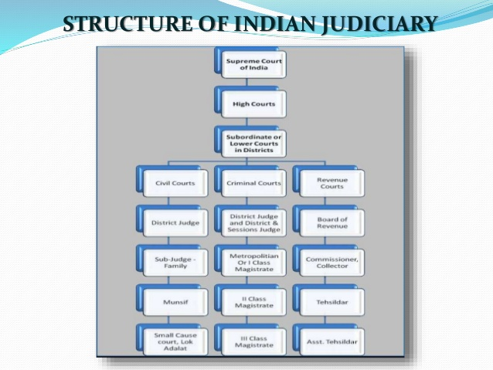

Slide 4
Public Prosecutors
Sequence of events:
Offence/Complaint
Investigation
Inquiry followed by charges
Trial may be:
Warrants case: punishable by death or life imprisonment or imprisonment above 2 years
Summons: offences punishable by imprisonment less than 2 years
Summary: punishable with fine or imprisonment not more than 6 months
Notes:
Advocates of not less than 7 years standing, appointed by HC or sessions court, for conducting any prosecution on behalf of Central or State Govt.
Investigation: Whenever an offence is committed or a complaint is registered, the police officer has to file an FIR. Then the police officer or other person is authorized by magistrate to collect evidence. The objective is to ascertain that an offence has been committed.
Steps: Proceed to the spot, ascertain facts and circumstances, discovery and arrest of suspected offenders, collection of evidence by examination of persons and taking statements, search of places, seizure of materials/things and ascertain if there is a case to place the accused before a magistrate for trial.
Inquiry: One step before trial. Carried out by Magistrate or court before a trial. Police report is presented to the magistrate and is satisfied of the facts. It states the name of offence, definition to give the accused notice of the matter with which he is charged. The law and section of the law against which offence is alleged to have been committed. Particulars of time and place of offence, particulars of previous punishment received by accused.
Trial: Final stage in judicial proceedings which ends in conviction or acquittal.

Slide 5
Trial: ends with conviction or acquittal
Accused, Prosecutor, Defence counsel, Magistrate
Outcome of judicial proceedings:
Inquiry: No prima facie case- accused may be discharged
Charges may be framed and accused is called upon to defend
Trial: Found guilty then punishment, acquitted if not guilty.
Punishment: Death, Life imprisonment, Imprisonment- Rigorous or Simple, Forfeiture of property, Fine
Exceptions: Child under 7 years, between 7-12 years, insanity, intoxicant administration without his knowledge

Slide 6
Types of Offences
Bailable: Bail is right of the accused, released on personal bond with or without sureties
Non-bailable offence: Bail may or may not be granted on hearing in the Court
Notes:
Bailable: being member of unlawful assembly, giving false evidence in judicial proceedings.
The accused may be released on bail, on executing a bond, know as "bail bond", with or without furnishing sureties.
The "bail Bond" may contain certain terms and conditions, such as:
The accused will not leave the territorial jurisdiction of the state without permission of court or police officer.
The Accused shall give his presence before police officer every time, he is required to do so.
The Accused will not tamper with any evidence whatsoever, considered by police in the investigation.
The court is empowered to refuse bail to an accused person even if the offence is bailable, where the person granted bail fails to comply with the conditions of the bail bond.
A non-bailable offence is one in which the grant of Bail is not a matter of right. Here the Accused will have to apply to the court, and it will be the discretion of the court to grant Bail or not.
Again, the court may require the accused to execute a "Bail-Bond with some stringent conditions.
The court may generally refuse the Bail, if:
"Bail Bond" has not been duly executed , or if the offence committed is one, which imposes punishment of death or Life imprisonment, such as "Murder " or "Rape" or
The accused has attempted to abscond, and his credentials are doubtful.
The application for bail shall be filed before the Magistrate, who is conducting the trial.

Slide 7
Cognizable offence: Police officer may take cognizance of an offence and arrest without warrant
Usually more serious
No complaint is necessary
Non-cognizable: Complaint is necessary to take action
Arrest:
Cognizable: Without warrant on credible information
Non-cognizable: warrant is necessary for arrest
In both cases, the accused to be informed of the grounds of arrest and his/her right to bail.
Without warrant- to be presented in court within 24 hours

Slide 8
Hierarchy and Powers of Courts
Supreme Court: Highest appellate court
High Court (every State + Benches): Try any offence under any law incl IPC
Sessions Court: Judge can pass any sentence under IPC, death sentence requires confirmation by HC
Other subordinate Courts: Metropolitan Court, Executive Magistrates
Notes:
Chief Justice of India and other judges are appointed by the President of India on the advice of the Cabinet of Ministers, in consultation with judges of SC and HC.
HC certifies whether the case is fit for appeal to SC. High Court present in State capitals (21 of them) with benches elsewhere. HC can try any offence under any law including IPC and pass any sentence.
Lower in hierarchy to HC is sessions court, judges are appointed by HC. Sessions Court can try any offence under IPC including offences with death penalty and life imprisonment. But death sentence needs confirmation by HC. Sessions court can pass only up to 10 years imprisonment.
Other courts such as Metropolitan Court, Court of Judicial magistrate appointed by HC. Met court for cities/towns with population greater then 1 million. Chief Met judicial magistrate can pass sentence to imprisonment less than 7 years and cannot pass death sentence. Special metropolitan judges appointed for one year for very small cases.
Executive Magistrates: Deal with administrative functions such as granting of licence, suspension of licence etc.
There are civil courts and criminal courts. There are tribunals specifically for trying special cases such as Railways Tribunal, Income tax Tribunal, Consumer court etc.

